Slide 1
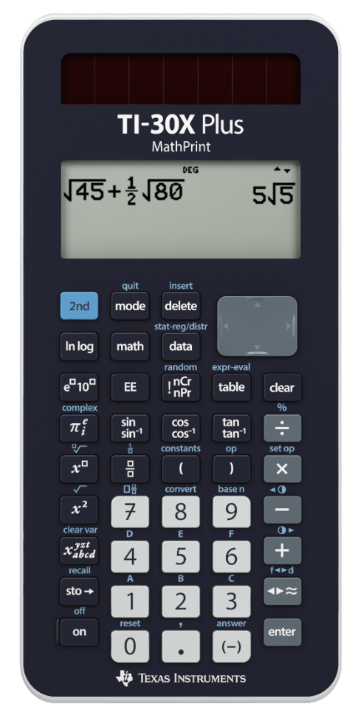
Tetrahedral Numbers

Slide 2
n =
1
Tetrahedral Numbers

Slide 3
n =
2
Tetrahedral Numbers

Slide 4
n =
2
Tetrahedral Numbers

Slide 5
n =
2
Tetrahedral Numbers

Slide 6
n =
3
Tetrahedral Numbers

Slide 7
n =
3
Tetrahedral Numbers

Slide 8
n =
3
Tetrahedral Numbers

Slide 9
n =
4
Tetrahedral Numbers

Slide 10
n =
4
Tetrahedral Numbers

Slide 11
n =
4
Tetrahedral Numbers

Slide 12
n =
5
Tetrahedral Numbers

Slide 13
n =
5
Tetrahedral Numbers

Slide 14
n =
5
Tetrahedral Numbers

Slide 15
5
Σ
x² + x
x = {1, 2, 3, 4, 5}
2
x = 1
Understanding Sigma

Slide 16
5
Σ
x² + x
x = 1
2
x = 1
1² + 1
=
2
Understanding Sigma

Slide 17
5
Σ
x² + x
x = 2
2
x = 1
1² + 1
2² + 2
=
+
2
2
Understanding Sigma

Slide 18
5
Σ
x² + x
x = 3
2
x = 1
1² + 1
2² + 2
3² + 3
=
+
+
2
2
2
Understanding Sigma

Slide 19
5
Σ
x² + x
x = 4
2
x = 1
1² + 1
2² + 2
3² + 3
4² + 4
=
+
+
+
2
2
2
2
Understanding Sigma

Slide 20
5
Σ
x² + x
x = 5
2
x = 1
1² + 1
2² + 2
3² + 3
4² + 4
5² + 5
=
+
+
+
+
2
2
2
2
2
Understanding Sigma

Slide 21
5
Σ
x² + x
x = 5
2
x = 1
=
1
+
3
+
6
+
10
+
15
Understanding Sigma

Slide 22
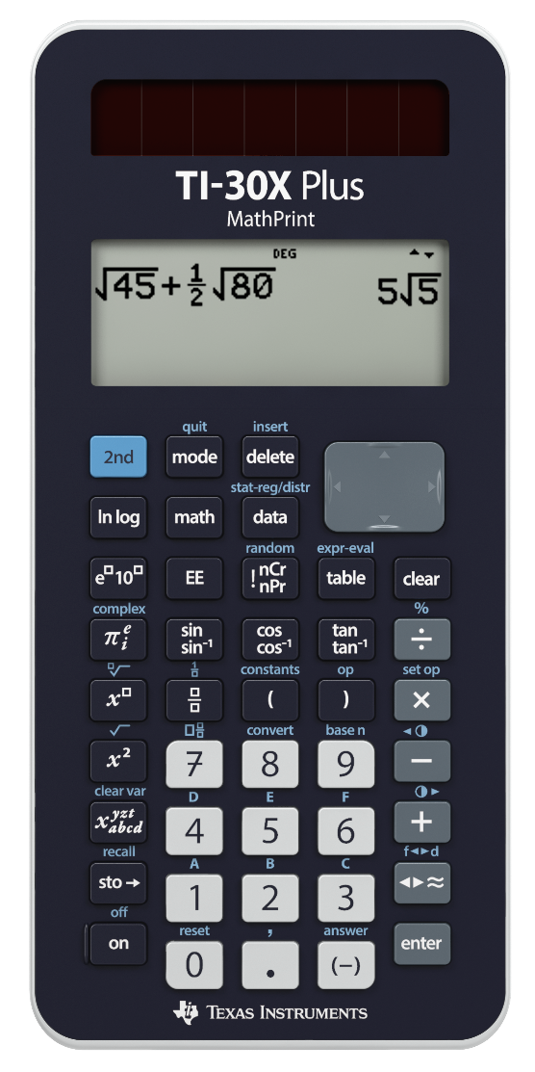
Pascal’s Triangle
Hidden Gem!

Slide 23
1
row =
0

Slide 24
1
row =
1
1
1

Slide 25
1
row =
2
1
1
1
2
1

Slide 26
1
row =
3
1
1
1
2
1
1
3
3
1

Slide 27
1
row =
4
1
1
1
2
1
1
3
3
1
1
4
6
4
1

Slide 28
1
row =
5
1
1
1
2
1
1
3
3
1
1
4
6
4
1
1
5
10
10
5
1

Slide 29
1
row =
6
1
1
1
2
1
1
3
3
1
1
4
6
4
1
1
5
10
10
5
1
1
6
15
20
15
6
1

Slide 30
1
row =
7
1
1
1
2
1
1
3
3
1
1
4
6
4
1
1
5
10
10
5
1
1
6
15
20
15
6
1
1
7
21
35
35
21
7
1

